Slide 1

Solar Consumer Protections
Presented to CSLB Enforcement Subcommittee
Commissioner Martha Guzman Aceves
February 4, 2021

Slide 2
Requesting CSLB Support on 2 issues
Enhanced Enforcement/Solar Transaction Portal
1. That the IOUs “need to implement changes to their interconnection portals to improve the quality and accuracy of information collected on solar providers and their agents.”
Recovery Fund
2. That there is “a need to fund restitution for customers who have been defrauded when attempting to go solar.”

Slide 3
Background
2016-2017 Current Net Energy Metering Program went into effect
July 2018- Public Workshop in Huron, CA
September 2018 - CPUC adopted Decision (D.)18-09-044, which established a process for creating a solar information packet for consumers.
March 2019- Formed Joint Solar Consumer Protection Taskforce (CPUC,CSLB,DBO)
September 2020 - Issued Assigned Commissioner Ruling for comment on Recovery Fund
January 2021 - Issued Assigned Commissioner Ruling for comment on Enhanced Auditing/EnforcementT

Slide 4
Petition for Modification (PFM) of D.2002011 by Joint IOUs- Submitted May 18, 2020
Opposes the Citation program focus on IOUs
Requests that CPUC modify decision to:
  to eliminate or defer any IOU citation program and instead continue exploring other options, such as:
    the registration program that remains under consideration,
    A secure portal for regulator access to documentation and information collected at interconnection,
    a taskforce to work with other enforcement agencies,
    increasing the frequency of spot audits,
    as well as others through stakeholder workshops and comments.

Slide 5
Assigned Commissioner Ruling- January 5,2021
Addresses Joint IOU Petition for Modification of D.2002011
Proposes to implement elements of CalSSA and IOU proposals
Enhanced Auditing program including:
  Solar Transaction Record Online Portal
    All required docs for consumer protection decisions easily accessible by CPUC, CSLB and DFPI: Solar Consumer Guide, CSLB Disclosure documents and license information, customer attestations, and other transaction details
  Increased number of semi-annual audits of interconnection documents
    Current decision requires 100 per IOU, proposes 1000 per IOU
    Half of the audits are targeted to contractors on a “watch list” and half are random.
  Watchlist mechanism to identify bad actors for increased monitoring

Slide 6
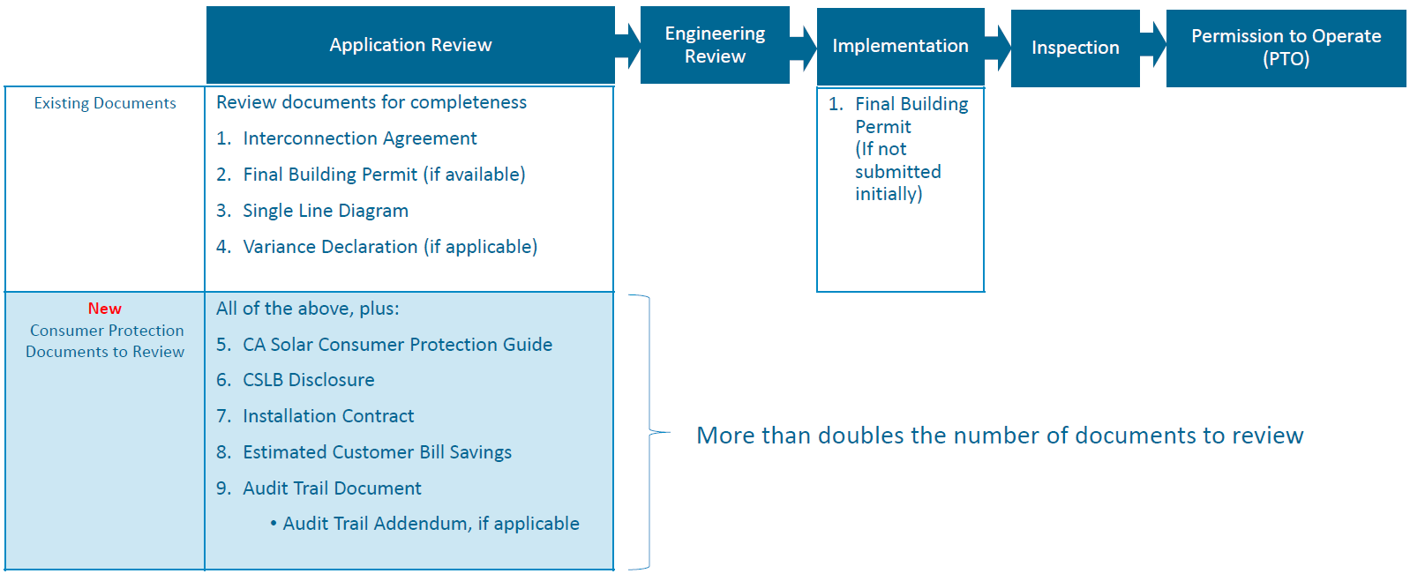
IOU Interconnection Review Process

Slide 7
CalSSA Proposal Watch List Concept
  A contractor is placed on the Watch List by the CPUC for the current quarter and the following quarter if:
    They have a violation of consumer guide requirements
    CSLB or CPED receive complaints that warrant being put on the list
Watch list is refreshed at the end of the quarter, removing contractors that do not have new issues
Targeted (real-time)visual inspections of interconnection applications
  The utilities do visual inspection of at least ten of that contractor’s applications as they are submitted BEFORE approval.
  This number increases by ten for each successive quarter that a contractor remains on the Watch List.

Slide 8
CalSSA Proposal- Visual Inspection Concept
Visual inspection means that the utilities inspect the following documents as they process interconnection applications rather than in a later audit:
  Consumer guide and attestation attachments
  Solar installation contract, including the CSLB cover sheet and supplemental forms
  Electronic audit trail for e-signatures
Rationale: Slowing the interconnection process for a contractor puts them at a major disadvantage in the competitive solar marketplace

Slide 9
Recovery Fund Proposal Status
Assigned Commissioner Ruling outlining Proposal issued September 3, 2020
Workshop held- Sept 22, 2020 with CSLB presenting
Comments and Reply Comments Submitted
ALJ drafting Proposed Decision now
Goal to bring for CPUC vote in Q1 2021

Slide 10
Guiding Principles for the Proposal
Efficient- an administrative recourse designed to assist victims of fraud
Retroactive –address legacy customers not protected from recent consumer protection measures
Effective – provides actual assistance
Shared responsibility – we all have a stake in reducing fraud, protecting consumers, ensuring the sustainability of solar for all

Slide 11
Overview of the Proposed Recovery Fund
Create a new Recovery Fund account overseen by the Commission to assist defrauded NEM customers
Funded by a new utility interconnection surcharge, with the amount based upon estimated budget and number of interconnections
Recovery Fund Administrator (RFA) would manage account and provide money to eligible claimants
RFA would only accept claims forwarded by the CSLB
Proposal here: https://docs.cpuc.ca.gov/PublishedDocs/Efile/G000/M346/K233/346233140.PDF

Slide 12
Eligible Claims- CSLB Role
Established criteria to ensure that the only cases referred to the RFA will be solar complaint cases in which the CSLB determined:
  that fraud/misrepresentation occurred, or
  that fraud/misrepresentation and/or poor workmanship or abandonment occurred;
  the consumer was financially harmed;
  payment of a specified sum to an injured party was established or an amount of restitution was ordered;
  and the consumer did not recover funds

Slide 13
Proposed Funding
We proposed funding the Recovery Fund with a new surcharge on Net Energy Metering solar interconnections
Based on CSLB data about recent complaints and costs, and an estimate of the number of annual interconnections:
  Estimated annual budget needed is $1.6 million
  Estimated new interconnection fee is $12.00
Some parties opposed the funding source, saying funds should come from solar companies and not customers

Slide 14
Questions/Comments?

